Slide 1
“03 PORTFOLIO WEBSITE”
Task - 1

Slide 2

Portfolio Website
A portfolio website typically includes a homepage that introduces the creator and provides an overview of their work. It also includes a gallery or portfolio section that showcases their best work in an organized and visually appealing way. Additionally, it may include a blog section to provide further context and insight into the creator's work, as well as an "About Me" page that gives more information about the creator's background, skills, and experience.
Overall, a portfolio website serves as a visual and interactive resume, allowing creators to highlight their talents and stand out from the competition in their field.

Slide 3
Portfolio Website
LMS Username | Name | Batch
2108a2963 | NATARAJAN K | A29_3
2108a2971 | PRAVEEN R | A29_3
2108a2976 | RAJESWARI M | A29_3
2108a29103 | VIGNESH V | A29_3

Slide 4
Task 1 :: SDP (Module 1)
ABSTRACT
A portfolio website is a digital platform designed to showcase a collection of someone's work, skills, and achievements. It serves as a visual and interactive resume for professionals from various fields, including artists, designers, photographers, writers, programmers, and more.
The website allows creators to present their best work in an organized and visually appealing way, providing potential clients or employers with a comprehensive view of their capabilities
A portfolio website is an essential tool for creators looking to establish their presence online and showcase their talents to the world.
SCOPE
The scope of a portfolio website is quite broad as it can be used by professionals from a variety of fields to showcase their work, skills, and achievements. Some of the most common fields where portfolio websites are widely used include:
Creative fields - such as art, design, photography, fashion, and writing.
Technology fields - such as web development, software engineering, and mobile app development.
Business fields - such as marketing, advertising, and consulting.
Education fields - such as teaching, e-learning, and instructional design.
Health and wellness fields - such as fitness, nutrition, and healthcare.

Slide 5
Task 1 :: SDP (Module 1)
REQUIREMENTS
Functional Requirements of a Portfolio Website:
User Registration and Login: The website should allow users to create an account and login to access their portfolio.
Portfolio Creation: The website should allow users to create a portfolio by adding their work, skills, achievements, and other relevant information.
Portfolio Editing: The website should allow users to edit and update their portfolios as they add new work or acquire new skills.
Portfolio Display: The website should allow users to display their portfolios in an organized and visually appealing manner, using categories, tags, or other filters.
Contact Form: The website should have a contact form that allows potential clients or employers to get in touch with the creator.
Social Media Integration: The website should allow users to integrate their social media profiles, such as LinkedIn or Instagram, to provide further context and insight into their work.

Slide 6
Task 1 :: SDP (Module 1)
REQUIREMENTS
Non-Functional Requirements of a Portfolio Website:
Usability: The website should be easy to use and navigate, with clear and concise menus and content.
Performance: The website should load quickly and respond to user actions promptly, without any delays or lags.
Security: The website should be secure, with robust measures in place to protect user data and prevent unauthorized access.
Compatibility: The website should be compatible with various devices and browsers, to ensure that it can be accessed by a wider audience.
Accessibility: The website should be accessible to users with disabilities, with features such as alternative text for images or transcripts for videos.
Scalability: The website should be designed to accommodate future growth, with the ability to handle larger traffic volumes or additional features as needed.

Slide 7
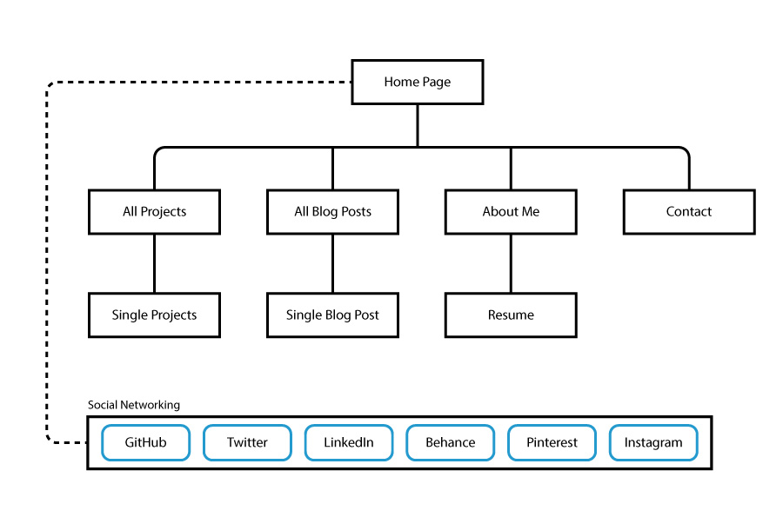
Task 1 :: SDP (Module 1)
SOFTWARE REQUIREMENTS
It requires a Scripting language HTML , and other languages such as CSS , Java Script
The web application can be easily achieved by the Microsoft Power Apps and Power Automate
HARDWARE REQUIREMENTS
It majorly doesn’t need any h/w requirements as it is a web application, But to run the web application we need a physical device such as mobile phones , personal computers or laptops , etc..,
ARCHITECTURAL DESIGN

Slide 8


Portfolio Website Hands-on
Click Here

Slide 9


